Slide 1
Description of WCF Custom UserName Security
Tao Zhou

Slide 2
Target
Know how to implement message security with custom username
How to choose Security mode, Client Credential type and Binding?
Know how message transfer?

Slide 3
Detailed steps to implement message security with custom username
Implement UserNamePasswordValidator class
set binding with security mode and clientCredentialType
set service behavior with service certificate and userNameAuthentication

Slide 4
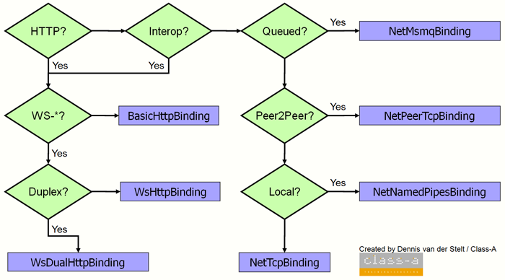
How to Choose Binding?

Slide 5
WCF Security
Authentication
Integrity
Confidentiality
Transport Security Mode
Message Security Mode
TransportWithMessageCredential Security Mode

Slide 6
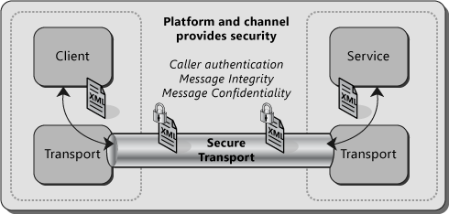
Transport Security
Transport Security use transport layer protocol to achieve three parts.
For WCF Http protocol Binding, use HTTPS
For NetTcpBinding, use SSL(Security Sockets Layer) Over TCP

Slide 7
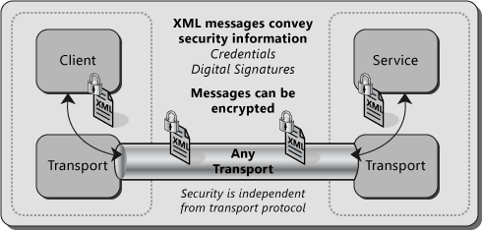
Message Security
Message security mode relay on message, and secure by sign and encrypt message
Application layer protocol, achieve authenticate in application layer

Slide 8
Transport Security VS Message Security
 | Transport | Message
Scenario | 1.Both service and consumer are located in an intranet 2.Send a message from consumer to service without be routed through intermediate systems | be forwarded to other service or be routed through intermediate system
Advantage | 1.Do not need to understanding ws-security 2.Better performance(transport layer, Network adapter hardware acceleration) | 1.Provide end-to-end, message security directly encrypts and signs the message 2.Allow partial or selective message encryption 3.Transport-independent and can use any transport protocol 4.Support a wide set of credentials and claims 5.Cross-Platform supported
Disadvantage | 2.Depend on transport protocol 3.Point-To-Point 4.Limit credential types(UserName is not supported) | 1.It does not support older asmx clients(both client and service need to support ws-security) 2. Reduce performance
Notes:
Web Services Security (WS-Security, WSS) is an extension to SOAP to apply security to Web services. It is a member of the Web service specifications and was published by OASIS.
The protocol specifies how integrity and confidentiality can be enforced on messages and allows the communication of various security token formats, such as Security Assertion Markup Language (SAML), Kerberos, and X.509. Its main focus is the use of XML Signature and XML Encryption to provide end-to-end security.

Slide 9
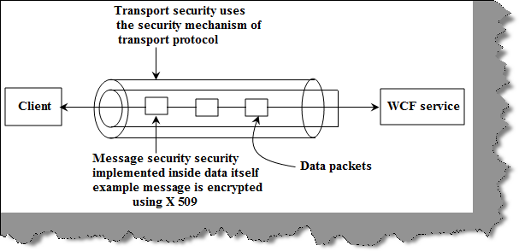
TransportWithMessageCredential Security Mode
S: Transport security with username credentials(do not have windows/domain credentials)
A:
Do not need windows/Domain credentials
Better performance
Message security credentials and claims
D:
Point-To-Point

Slide 10
Client Credential Type For Transport and Message
Transport
Setting | Description
None | No credential. This translates to an anonymous client.
Basic | Send a Base64-encoded string that contains a user name and password in clear text
Digest | A replace of Basic,unencoded user name and password, operating system need to support Windows domains
Ntlm | A replace of Digest, uses windows credentials instead of unencoded user name and password(NTLM authentication)
Windows | Kerberos protocol on a windows domain
Certificate | Performs client authentication using an X.509 certificate.
Message
Setting | Description
None | No credential. This translates to an anonymous client.
Windows | security context established with a Windows credential.
Username | Allows the service to require that the client be authenticated with a user name credential
Certificate | Allows the service to require that the client be authenticated using an X.509 certificate.
Issued Token | A custom token type configured according to a security policy. The default token type is Security Assertions Markup Language (SAML).
Demo Case
The request for security token could not be satisfied because authentication failed

Slide 11
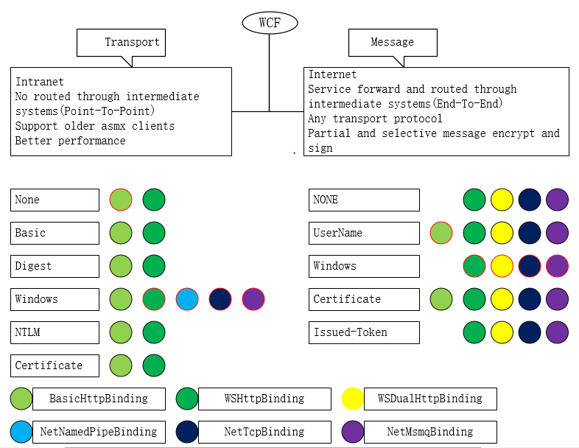
How To Implement Security?
Notes:
Message security don’t support NetMsmqBinding and NetNamedPipeBinding
Transport security does not work with wsDualHttpBinding

Slide 12
How message transfer between client and service?

Slide 13
Thank you

